Slide 1
Our Story
about how we would like to live together

Slide 2
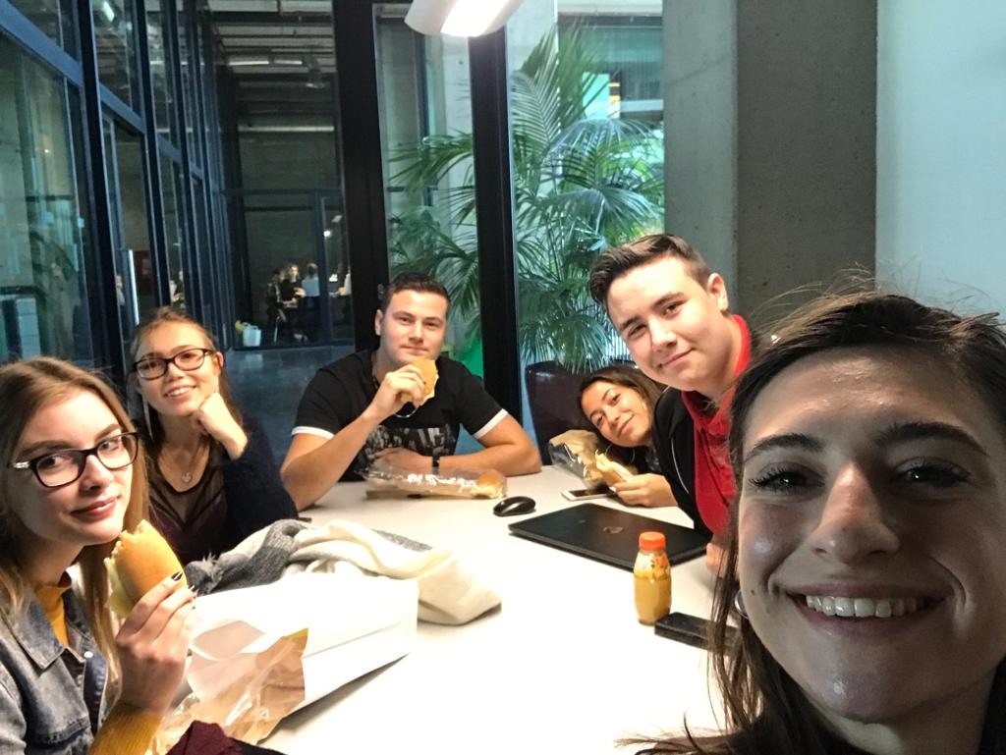
Our Team !

Slide 3
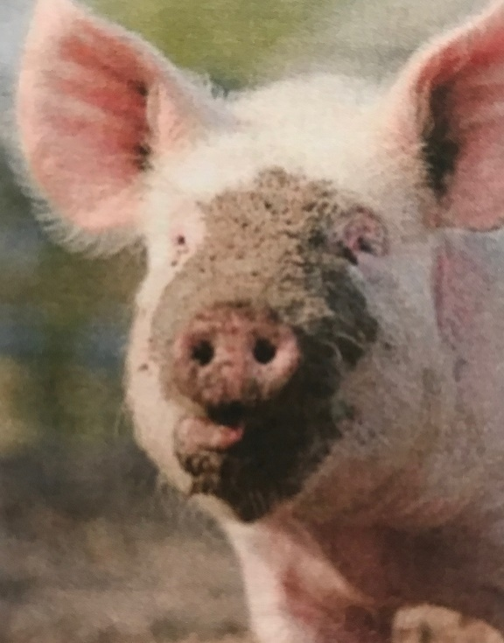
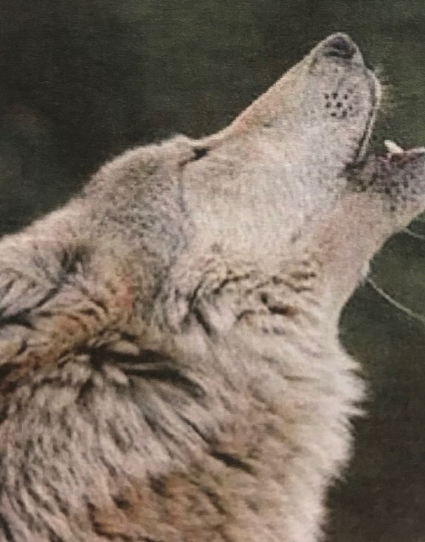
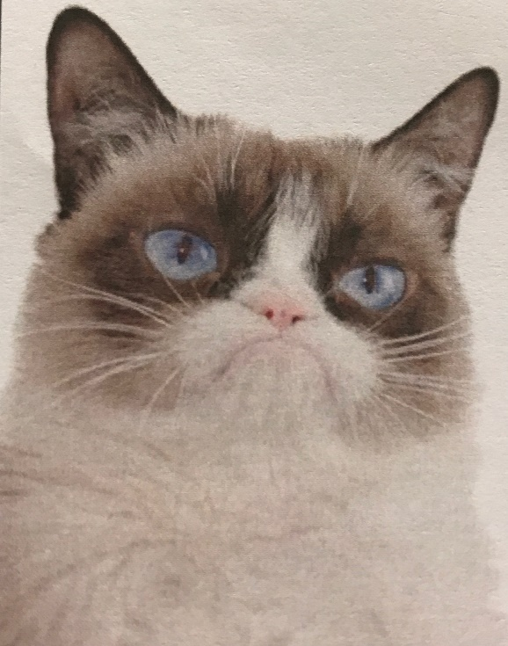
Our four different personalities
MONIKA
KYLIAN
PAUL
NATALIA

Slide 4
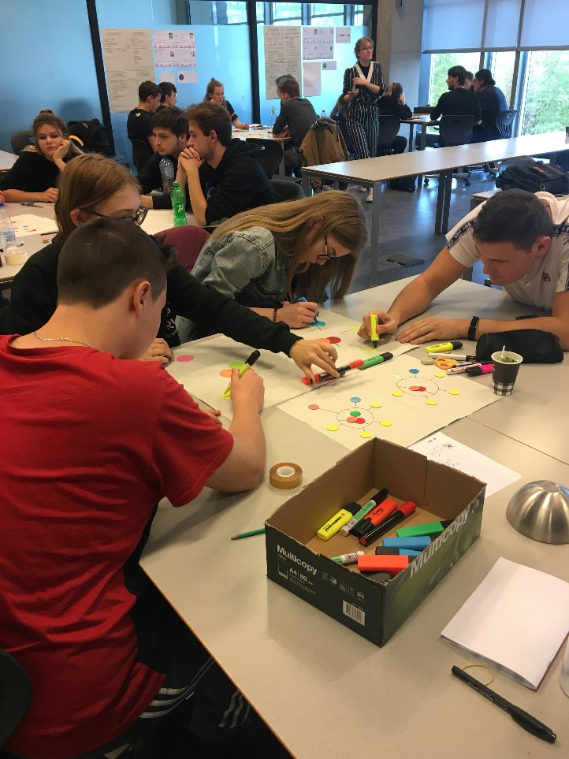
What we find important
To understand the difference between private and public space
To take care of a shared space
To have discussions and solve problems
To work together
To spend time with each other

Slide 5
Our similarities and differences

Slide 6
Our public and private spaces

Slide 7
The first ideas about our common house

Slide 8
What extra spaces we bought and how we organized our future home

Slide 9
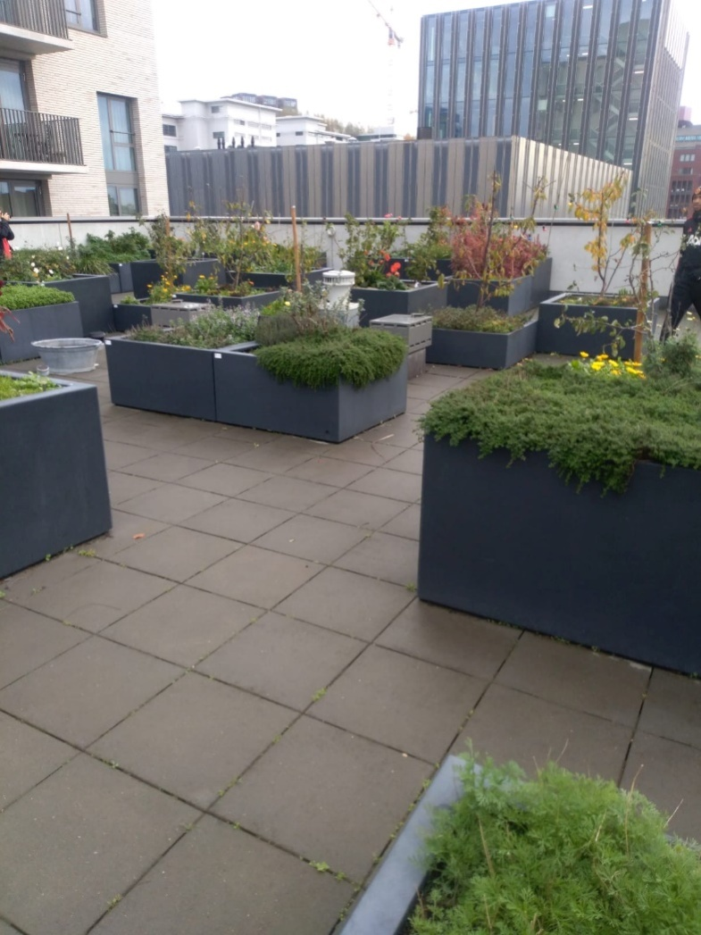
How imagine some of our shared spaces
Shared garden to learn how to take care of shared spaces
Shared kitchen to eat together

Slide 10
Our House Rules

Slide 11
Our model of a hotel

Slide 12
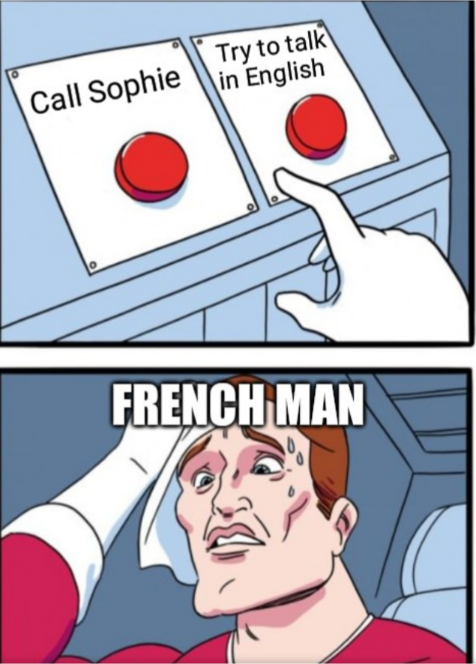
Our fun times with all of you !

Slide 13
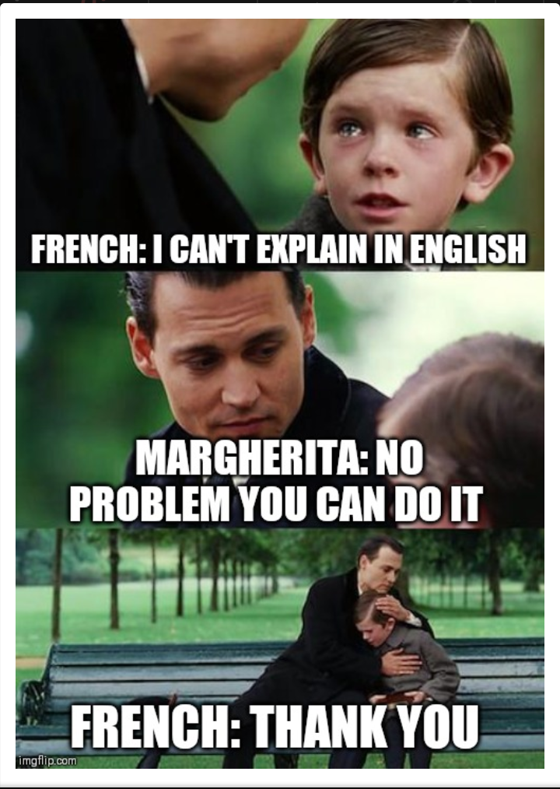
Our fun times with all of you !

Slide 14
Our new skills

Slide 15
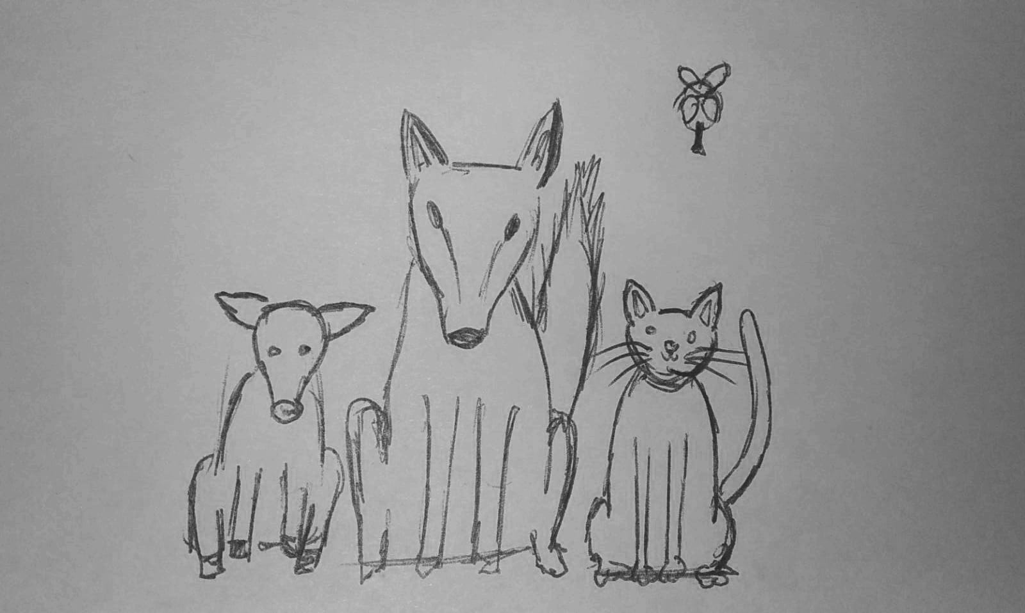
Thank you !

